Slide 1
Employee Data Analysis using Excel
STUDENT NAME:D.N.KARTHIKRAJA
REGISTER NO:312214241
NAAN MUDHALVAN ID: 31FA2337FE0ADE19558497BF3E07E54C
DEPARTMENT:B.COM [A&F]
COLLEGE: ST.Thomas College of Arts And Science

Slide 2
PROJECT TITLE
Employee Salary dataset
Analysis using Excel

Slide 3


AGENDA
Problem Statement
Project Overview
End Users
Our Solution and Proposition
Dataset Description
Modelling Approach
Results and Discussion
Conclusion
3/21/2024 Annual Review

Slide 4

PROBLEM STATEMENT
.Statistical models can be applied to predict base salaries based on factors such as department, grade, and length of service. Machine learning techniques could also be employed to identify patterns and anomalies in the salary data, such as outliers or instances of significant inequity.

Slide 5

PROJECT OVERVIEW
This dataset contains information about the salaries of employees at a company. Each row represents a different employee, and the columns include information such as age, gender, education level, job title, years of experience, and salary.
.

Slide 6

WHO ARE THE END USERS?
An employee database can be used by human resources staff to track employee data and it’s also be used by the organisation accounting staff to track payroll data

Slide 7

OUR SOLUTION AND ITS VALUE PROPOSITION
An employee value proposition is a statement that outlines the benefits and employees can expect to receive from working of company.
It includes the employee receive in exchange of contribution to company

Slide 8
Dataset Description
Salary represents a fixed and predetermined remuneration granted by an employer to an employee in exchange for their provided services or work. Typically stated as an annual sum, salaries are often distributed at regular intervals, such as monthly or bi-weekly.

Slide 9

THE "WOW" IN OUR SOLUTION
The salary structure typically includes basic salary, allowances, and other indirect components. Gross salary is the sum of all components. Net salary is the amount received after tax deductions. CTC includes all indirect benefits and components such as basic salary, PF, gratuity, and allowances.
3/21/2024 Annual Review

Slide 10
MODELLING
A payroll management system describes the specialist software that can empower companies by streamlining and automatically carrying out the processes involved in payroll such as working out take home pay and taxes saving time for the employer and reducing the number of errors.

Slide 11
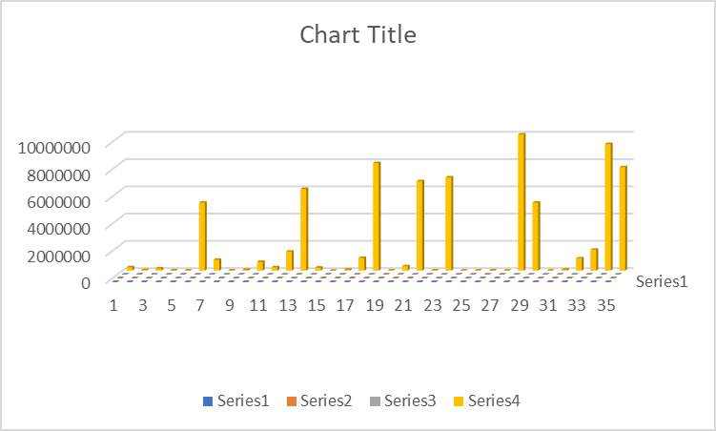
RESULTS

Slide 12
conclusion
An employee salary database is important for organizations to ensure they pay employees correctly and comply with regulations. It can also help improve personnel management and protect employers from fraud claims.

